Slide 1
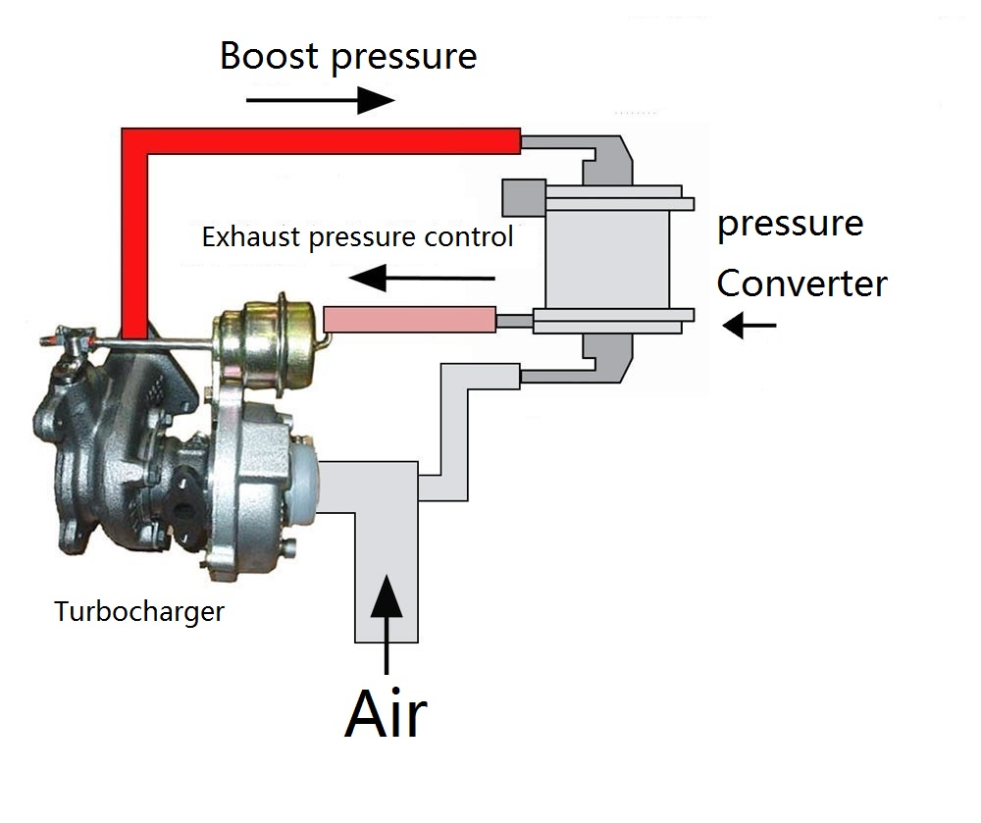
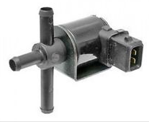
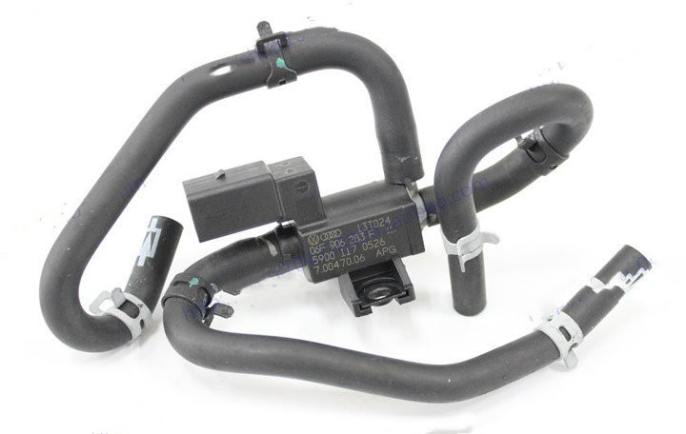
Pressure Solenoid Valve
According to the received pulse frequency signal from the engine ECU, the intermittent opening, closing, opening, closing, opening and closing is completed. When the frequency is higher, it is almost equivalent to full opening. When the frequency is low, almost Equivalent to full clearance, in this way to achieve flow and pressure of the overcurrent (airflow).
Always working when you start engine !
Ref.:06F 906 283 F
for Audi

Slide 2
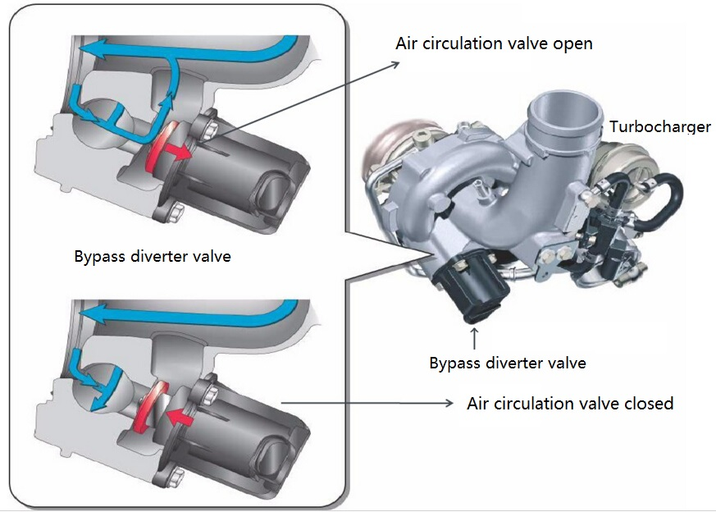
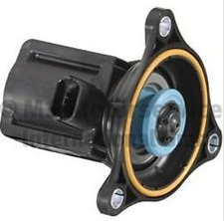
Bypass Diverter Valve
Excessive high pressure air from the intake turbine after compression in the pressure relief pipe
Bypass diverter valve is designed to maintain maximum boost pressure and protect the turbine
Ref.:12798364
for Opel
Always working when you start engine !

