Slide 1
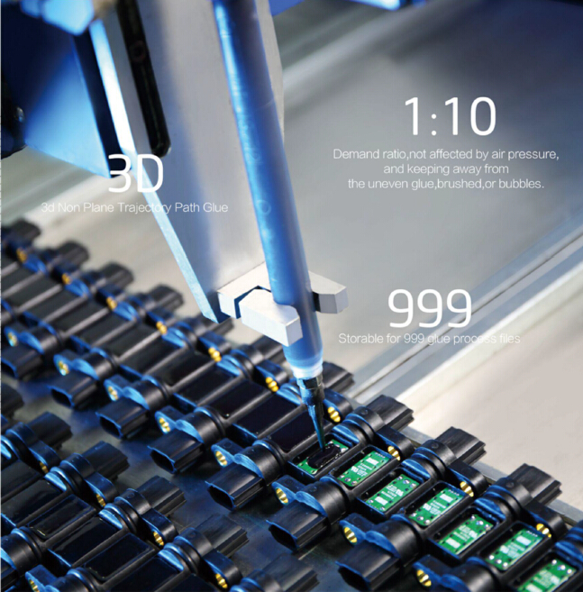
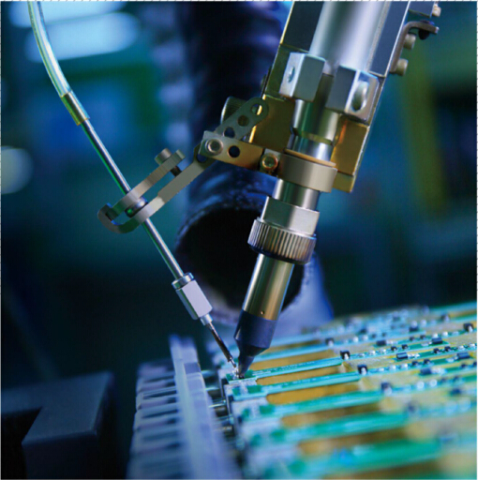
Tin Solder Robot Machine
Quality
We make 100% inspection for semi-finished product and finished product to ensure the quality of each product.
Automatic Epoxy Filling Machine

Slide 2
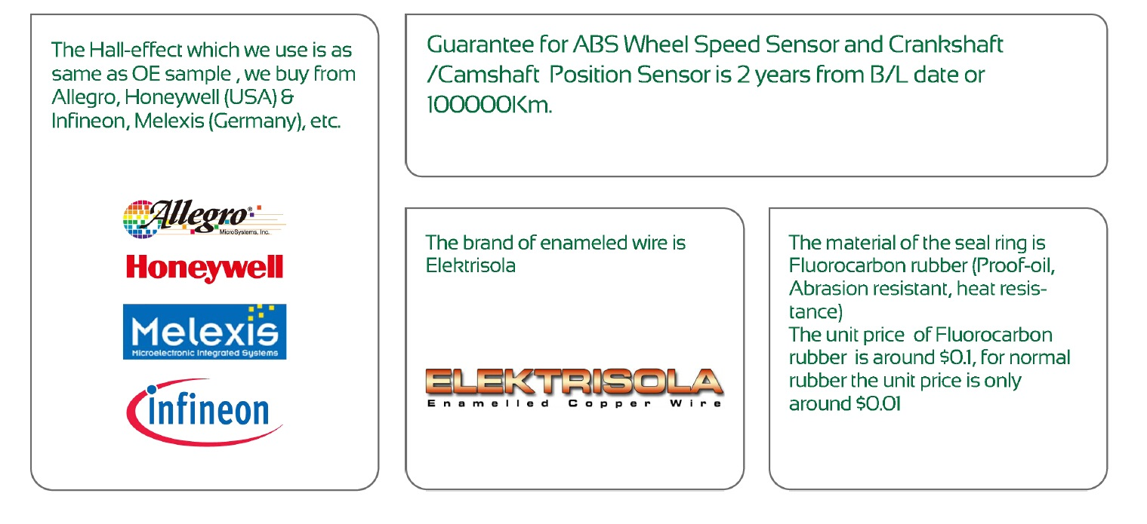
Quality

Slide 3
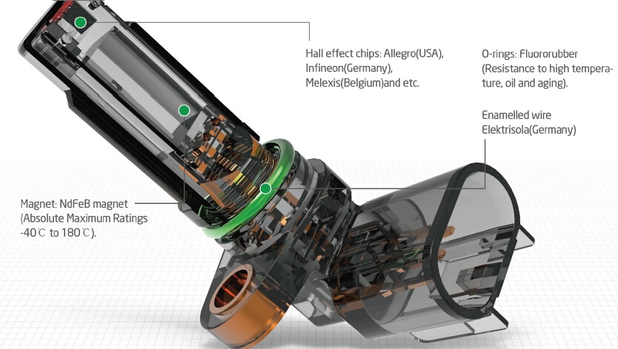
Quality

Slide 4
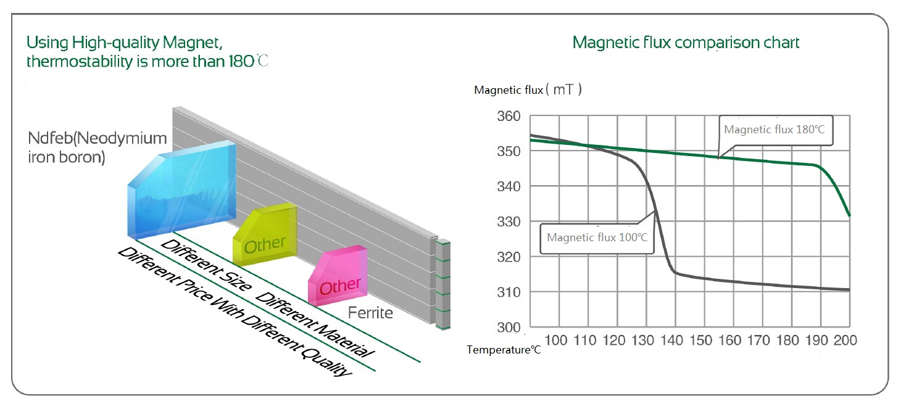
Quality
AP

