Slide 1
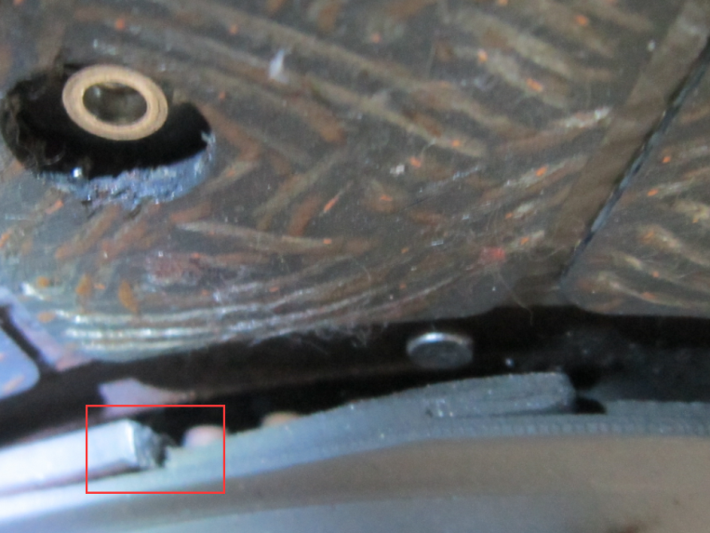
Clutch disc standard
Clutch disc test
Test Items | Technical Specifications |  | Test Method
Torsion of clutch disc | reduce the breakdown torque by 5% and with 500,000 times of fatigue test, should be in accordance with the following requirement | a. Breakdown torque should not lower than 80% of the initial value | QC/T 25-2014 "TECHNICAL SPECIFICATION OF AUTOMOBILE CLUTCH"
Fatigue test |  | b. Friction damping torque of the torsional vibration damper should not lower than 60% of the initial value
 |  | c. No parts should get failed
COMPETIROR TEST RESULTS
Test Results | Item Conclusion | Remarks
Disc steel get damaged after 400,000 times of fatigue test. | failed

Slide 2
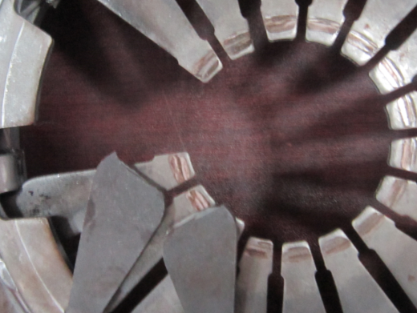
Clutch cover fatigue standard
Clutch cover fatigue test
Test Items | Technical Specifications |  | Test Method
Fatigue test for clutch cover | In ordinary temperature, after 500,000 times of static releasing fatigue test, should be in accordance with the following requirement. | a. The change of max releasing force should not be 15% more than the initial value | QC/T 25-2014 "TECHNICAL SPECIFICATION OF AUTOMOBILE CLUTCH"
 |  | b. The clamping force should not be less than 90% of the initial value
 |  | c. The lifting of the clutch cover should not less than 90% of the initial value
 |  | d. No parts should get failed
COMPETIROR TEST RESULTS
Test Results | Item Conclusion | Remarks
Diaphragm spring get broken shortly in 300,000 times’ fatigue test | failed

Slide 3
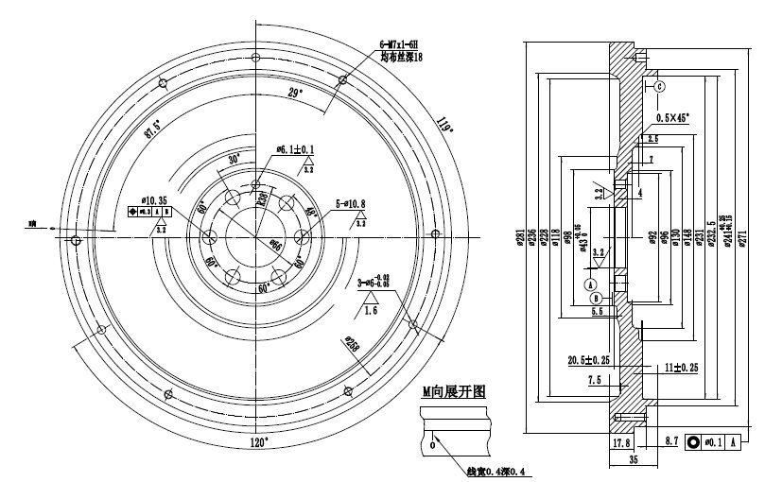
Flywheel standard
Flywheel test
Up to 50 testing items
Chemical composition of raw materials
mechanical properties
hardness
appearance
Unbalance
Crankshaft mounting surface runout
Crankshaft installation surface roughness
Bearing hole
Thickness of pin hole
Bearing hole roughness
Diameter of pin hole
Dimeter of pin
Pin position
Diameter of flywheel locating hole
Position of flywheel locating hole
Verticality of positioning hole
Locating hole roughness
Center distance between locating hole and bearing hole
Position depth of gear ring
threaded hole
Position of thread hole
Circumference of thread hole position
Depth of threaded hole
Roughness of threaded hole
dowel hole
Depth of dowel hole
Position of dowel hole
Large face diameter
Height of large face to crankshaft surface 大端面内径
Crankshaft mounting surface diameter齿圈与飞轮间隙
Outer diameter of gear ring
Gear ring common normal line
Location diameter of gear ring
Bottom circle of gear ring
Thickness of crankshaft mounting surface to friction surface
Total thickness
Location roughness of gear ring
Gear ring runout
Planeness of friction surface
Runout on friction surface
Roughness of friction surface
Inner diameter of small end face ①②
Depth of friction surface
Mouth depth
Mouth diameter

Slide 4
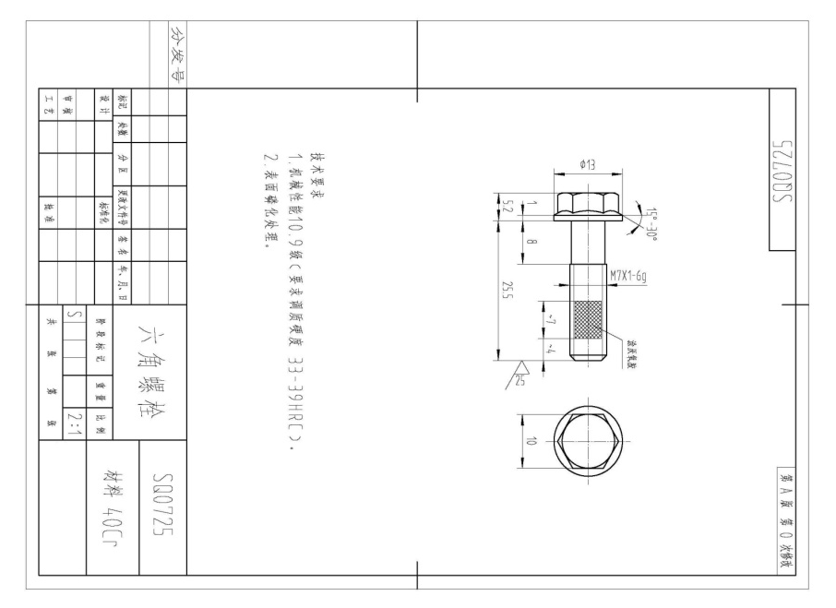
Rivet standard
Rivet standard

Slide 5

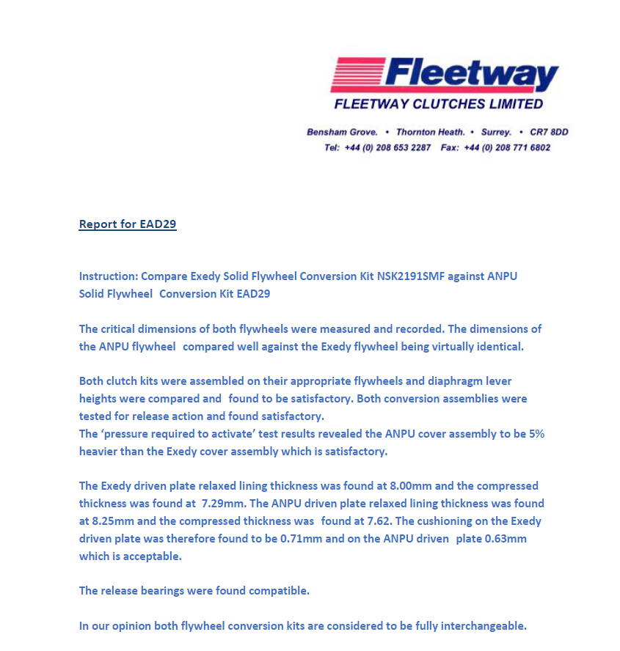
Kits final test
Kits final test by third party
Compare with Valeo

Slide 6
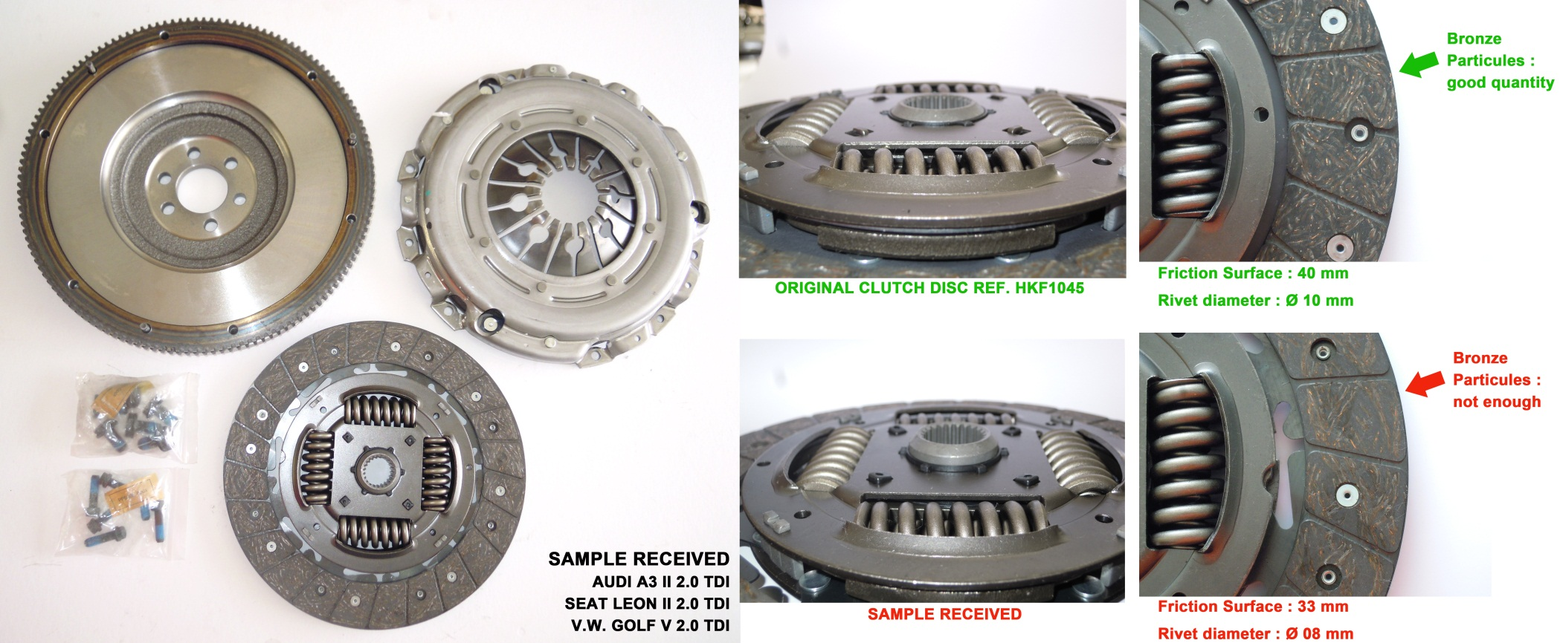
Experience
Experience

